Slide 1
Costing MMS:
Approach, Methodology, Tool

Slide 2
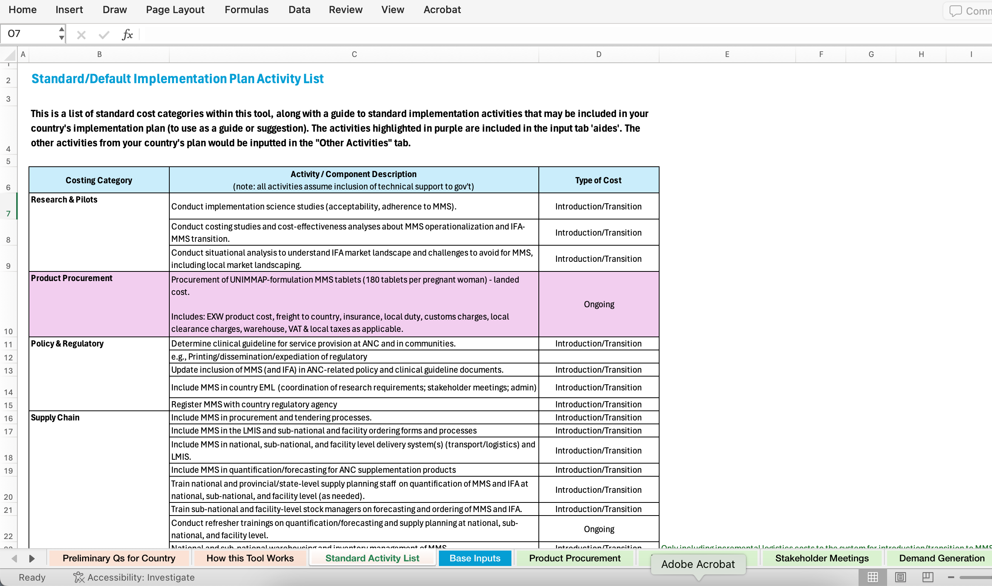
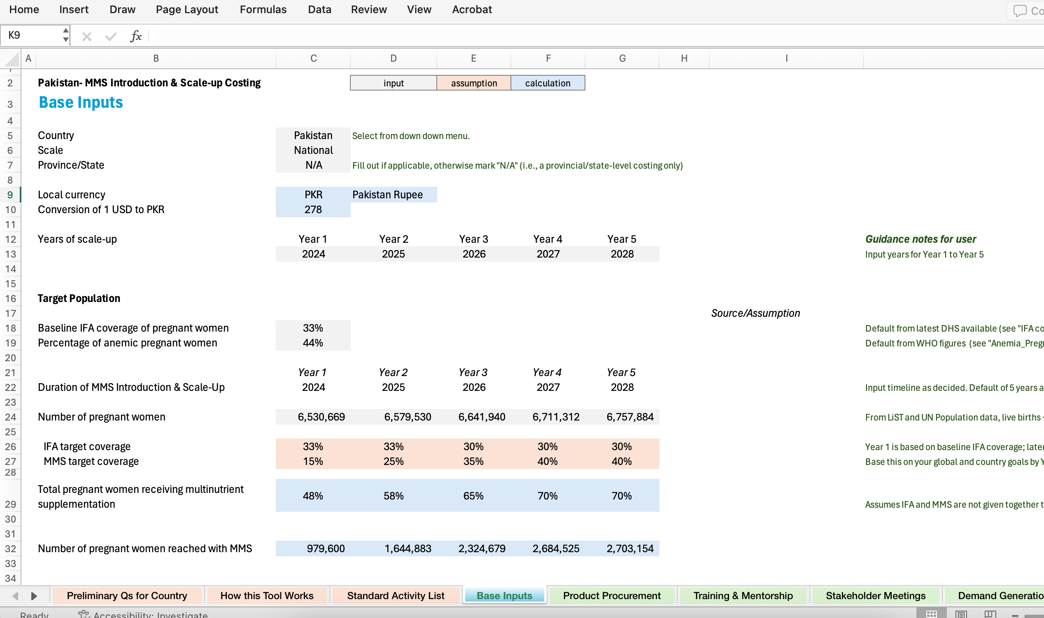
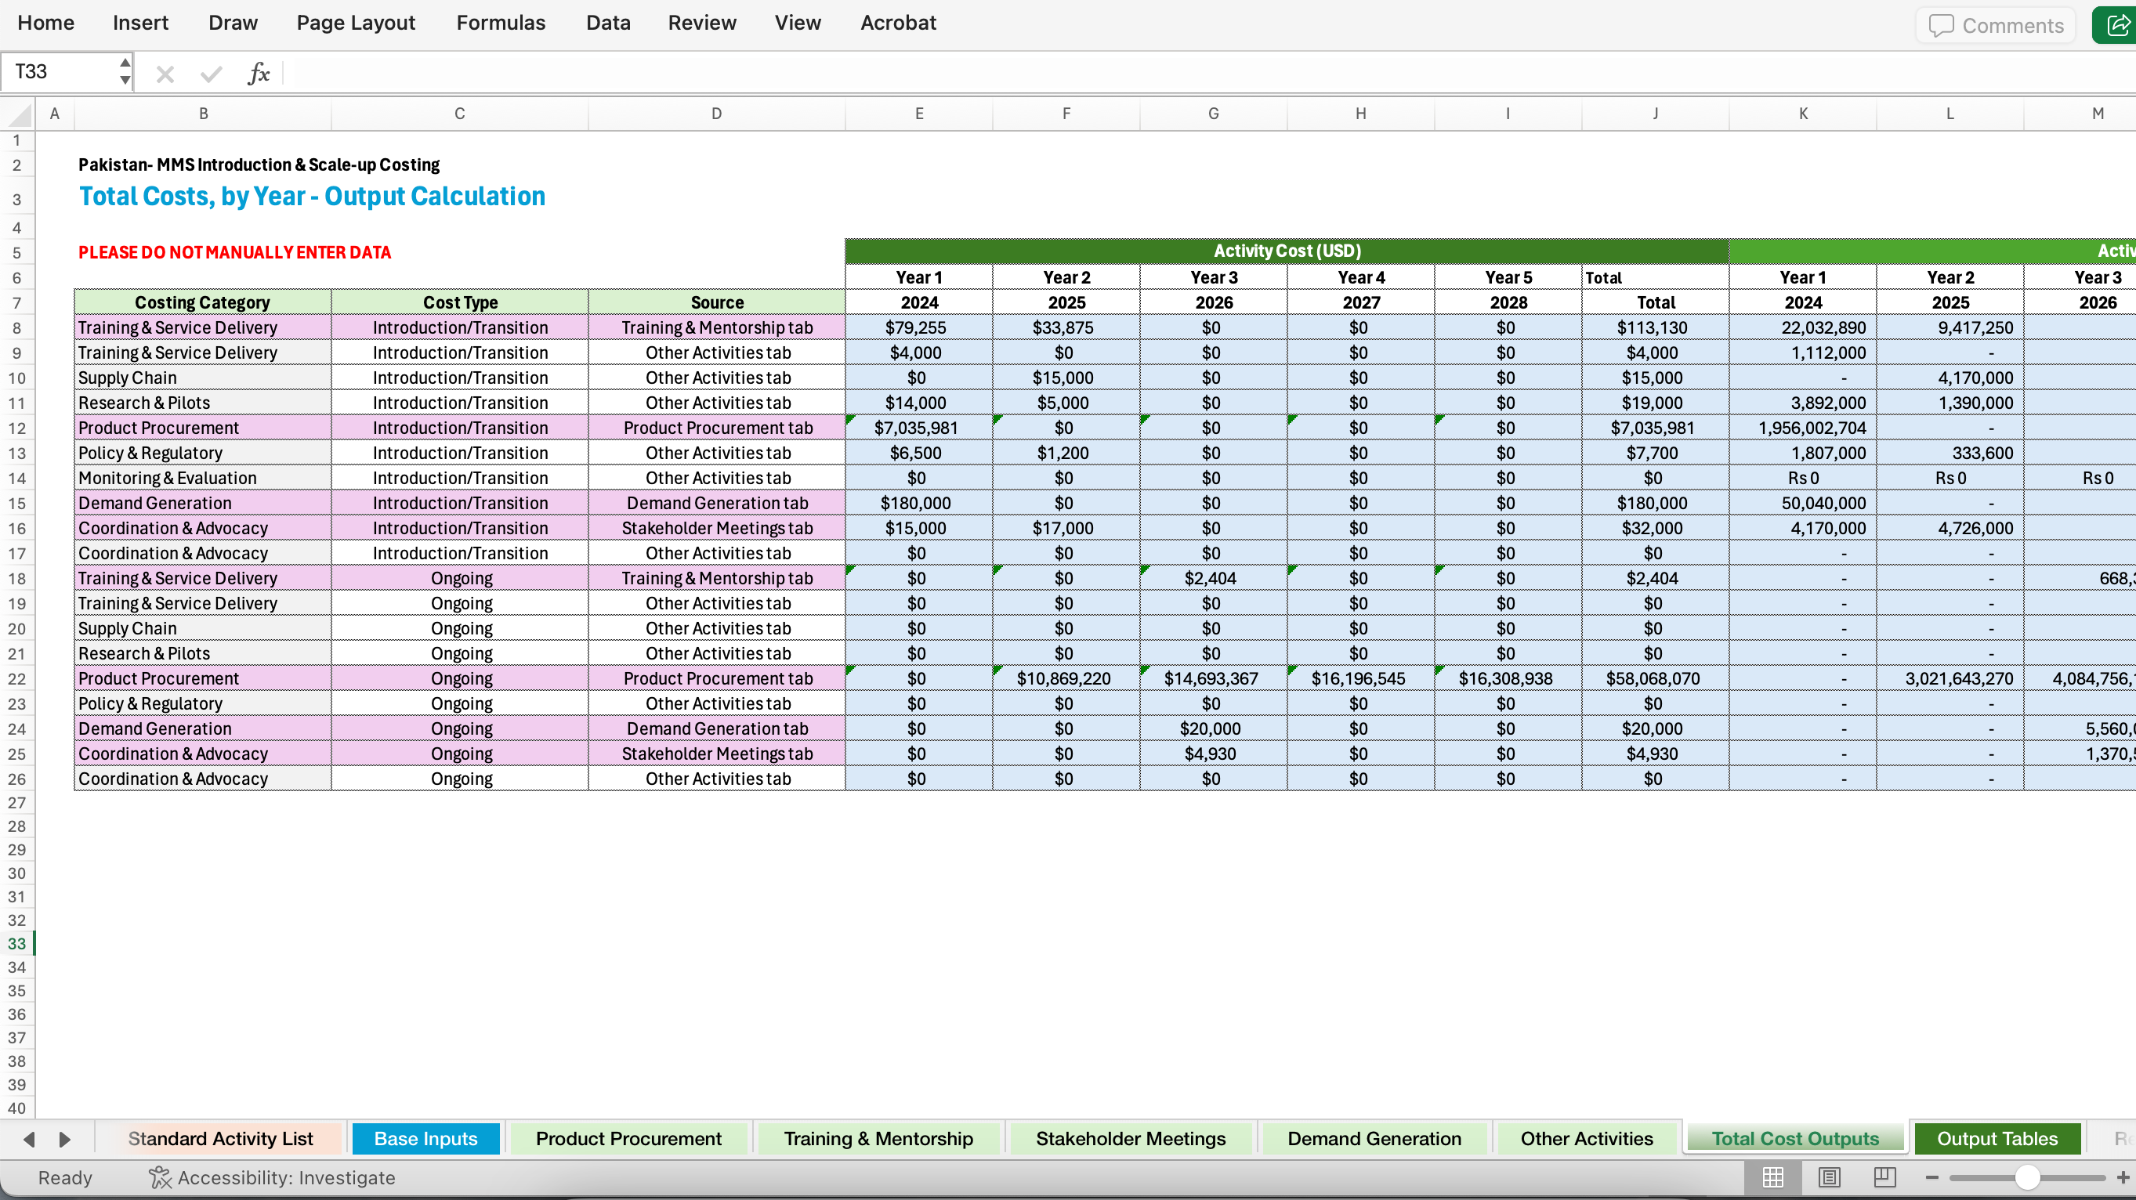
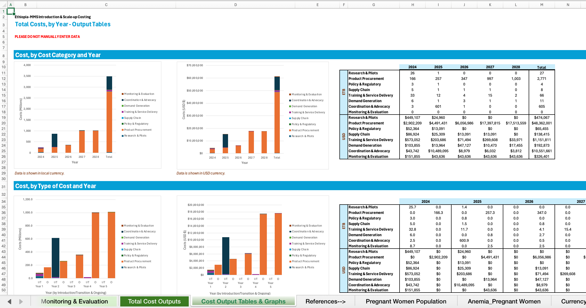
What does the costing tool do?
It helps you input:
Costs for your country’s implementation plan activities in standard categories.
It outputs:
The total cost of the MMS introduction and scale-up implementation plan, by year, cost category, and type of cost
The cost per pregnant woman reached, by year

Slide 3
What does the costing tool NOT do or include?
Note: This tool is not a cost-effectiveness or cost benefit tool (it is meant to support costing and calculation of the MMS funding requirements).
The following cost components are excluded from the MMS implementation plan costing:
Government healthcare system worker fixed salaries or related compensation structures (e.g., national/provincial/district-level officials; HCWs at facility and community-level).
Activities by global and bilateral partners that related to market-shaping interventions (e.g., global access price negotiation, multi-country demand forecasts)
Routine supply chain costs (incremental costs to introduce/establish MMS in the supply system are included).
Routine nutrition or related-ANC activities.
Costs to patients (e.g., transportation, lost wages, etc.).
Capital investments, such as construction, renovations, water and sanitation infrastructure, or agricultural equipment
Support to private sector service providers for introduction and/or provision of MMS.

Slide 4


The overall approach
Activity-Based Costs…
…per Year…
…in standardized Cost Categories
Cost Categories
Research & Pilots
Policy & Regulatory
Product Procurement
Supply Chain
Training & Service Delivery
Demand Generation
Coordination & Advocacy
Local Market Shaping
Monitoring & Evaluation
Based on the activities in the implementation plan, a cost is calculated for each activity.
Activities and their costs are organized by year, with a default 5-year timeline assumed.
If the timeline is shorter than this, non-applicable years can be left blank within the costing tool.
Activity cost inputs are organized into one of nine cost categories.
Activity costs are summed up to calculate total costs.

Slide 5




Inputs: Target population reached (coverage)
Target Population
Target Coverage of MMS
Number of pregnant women reached with MMS
 | Year 1 | Year 2 | Year 3 | Year 4 | Year 5
Target Coverage % | 15% | 25% | 45% | 50% | 60%
The number of pregnant women in the selected country is automatically populated based on UN Population data (live births + still births) or can be manually inputted.
MMS target coverage rates are inputted based on
MOH country targets.
The target number of pregnant women reached with MMS is used to calculate how much MMS should be procured.
The quantity of MMS product to procure

Slide 6
Inputs: Cost categories
Cost Categories | What it includes (non-exhaustive)
Research & Pilots | Situational analysis, implementation research, evidence-building, costing or cost-effectiveness studies
Policy & Regulatory | Activities to update policy and clinical guidelines, and register MMS in the country
Product Procurement | Landed product cost, including shipping to country, customs clearance, wastage, warehousing, taxes
Supply Chain | Activities to add MMS to routine supply chain systems, including LMIS and printed forms/materials; logistics costs if incremental to routine supply chain costs; related training to forecasting/ordering officials.
Training & Service Delivery | Development of training manual & materials; training and mentorship & supervision from national to local/community levels
Demand Generation | Social behaviour change activities & materials for pregnant women, and their families, for MMS awareness-building and to improve adherence
Coordination & Advocacy | Stakeholder meetings for the purposes of any coordination and advocacy (e.g., for policy/regulatory, implementation planning, and/or financing plan purposes)
Local Market Shaping | Activities related to in-country market shaping for better supply security (e.g., technical assistance/advisory to local manufacturers, regional market negotiations or partnerships)
Monitoring & Evaluation | Activities to include MMS in the national/sub-national M&E system, related training to M&E officials, support to review and update the MMS implementation plans over time

Slide 7
Inputs: Types of cost
Introduction/Transition Costs
Ongoing Costs
Expected in the earlier years of the implementation plan (but not restricted to just Year 1) and required to introduce MMS into the country's health system and scale-up.
Significant drivers of introduction/transition costs are healthcare worker training and the advocacy & coordination activities to plan, implement, and secure financing for MMS introduction and scale-up.
Common areas of cost variability come from the extent of activities towards demand generation, and the upfront investment in strengthening of supply chain and ANC & community services to improve coverage in introduction and early-scale-up years.
Expected to be recurring annually for ongoing delivery of MMS.
A significant driver of ongoing cost is annual product procurement cost.
Common areas of cost variability come from the extent of mentorship & supervision of healthcare workers, what recurring demand generation activities, and what recurring strengthening of ANC & community services will look like.

Slide 8
Outputs
Total cost of MMS implementation plan,
by year
By type of cost
Cost per pregnant woman reached, by year
By cost category
Total cost in X year / number of pregnant women reached in X year
Introduction/Transition, Ongoing
Research & Pilots
Policy & Regulatory
Product Procurement
Supply Chain
Training & Service Delivery
Demand Generation
Coordination & Advocacy
Local Market Shaping
Monitoring & Evaluation
Can also output cost category by type of cost

Slide 9
Things to know
An implementation plan development template is not prescribed within the tool, although examples of expected activities are listed for support/reference.
  Inputs to the tool are meant to be adaptable to a country’s plan and its corresponding activities.
Activities should be slotted into one of the nine cost categories (mutually exclusive, collectively exhaustive - MECE).
  For activities that are related to strengthening the health system (e.g., ANC and/or community capacity), put the activities where you think they most belong, within the cost categories.

